Slide 1
Week 10
Transaction – Motivation for the need for Transactions

Slide 2
Student Objectives
Upon completion of this video, you should be able to:
Give 2 scenarios where transactions are required
Define the term transaction
Give the meaning of each of the 4 properties in acronym ACID
Give an example of at least 3 types of things that could happen that would cause problems
List the 3 SQL commands used to build transactions
Explain why logs are necessary in database management systems

Slide 3
Imagine:
Situation 1: Homer moving 50 dollars from his savings account to his checking account where:
Get the account balance of the savings account
If the Homers&Marge's savings account has more than 50 dollars in the savings account, subtract the 50 bucks from the savings.
Add the 50 bucks to the checking balance.
Situation 2: Marge is going to deduct 75 dollars from the SAME savings account as Homer
Get the account balance of the savings account
If the Homers&Marge's savings account has more than 75 dollars in the savings account subtract the 75 bucks from the savings.

Slide 4
2 Possible Problems:
QUESTION: Just consider problem 1 on it's own. What could go wrong with just problem 1?
UPDATE jointaccount SET balance = balance - 50 WHERE cusID = “homer123” AND type=“saving”;
UPDATE jointaccount SET balance = balance + 50 WHERE cusID=“homer123” AND type=“chequing”;
QUESTION: Now consider problem 2 with 2 different things happening at the same time. What could go wrong? Assume account has 100 dollars.
Homer does: SELECT balance FROM jointaccount WHERE cusID = “homer123”; UPDATE jointaccount SET balance = balance - 50 WHERE cusID=“homer123”;
Marge does: SELECT balance FROM jointaccount WHERE cusID = “marg123”; UPDATE jointaccount SET balance = balance - 75 WHERE cusID = “marg123”;

Slide 5
What is a transaction?
A transaction is a sequence of database operations, where the execution of the operations preserves the consistency of the database (a Logical Unit of Work)

Slide 6
SOLUTION: Transactions:
TRANSACTION 1: A Transaction for Homer moving 50 dollars from his savings account to his checking account where:
Begin Transaction
Get the account balance of the savings account
If the Homers&Marge's savings account has more than 50 dollars in the savings account, subtract the 50 bucks from the savings.
Add the 50 bucks to the checking balance.
Commit
TRANSACTION 2: Another transaction for Marge, she is going to deduct 75 dollars from the SAME savings account as Homer
Begin Transaction
Get the account balance of the savings account
If the Homers&Marge's savings account has more than 75 dollars in the savings account subtract the 75 bucks from the savings.
Commit

Slide 7
Problems that can occur during the middle of a transaction:
System Crash: Example --> Main Memory Failure
Transaction or System Error: Example → Division by zero
Local/Exception Errors: Example → Not being able to access or find data
Concurrency control enforcement: Example → Concurrency may abort a transaction and restart it later
Disk Failure: Example → Read/Write Head Crash
Catastrophes: Example → air conditioning failure, fire, theft, overwriting disks by mistake

Slide 8
The ACID Test
The transaction must take the database from a consistent state to another consistent state, thus the initial state before the Begin Transaction of transaction 1 is a consistent state, and after the Commit it is a consistent state but in-between that the database is in an inconsistent state because it violates integrity and semantic rules.
The DBMS must be able to recover the database to a previous consistent state if for some reason some happens in the middle of the transaction.

Slide 9
EVERY TRANSACTION MUST PASS THE ACID TEST:
Atomic: All or nothing: All parts of the transaction MUST be executed, thus in the above example, all steps are thought of as 1 atomic transaction where either all are completed or none are completed
Consistency: A transaction must transform the database from one consistent state to another consistent state.
Isolation: Data used during the execution of the a transaction cannot be used by a second transaction until the first one is completed (runs as if in isolation)
Durability: When a transaction is completed, the database has reached a consistent state and that state cannot be lost, even if there is a system failure. The changes made by the transaction are durable, i.e. will survive certain types of systems crashes.

Slide 10
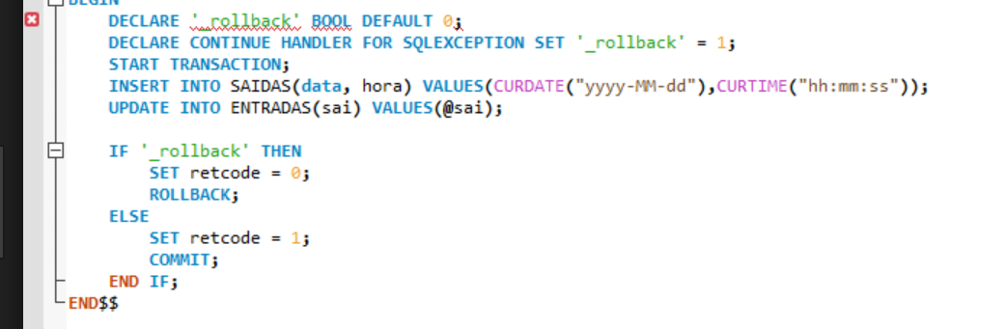
Transactions are supported in SQL with the use of 3 commands:
Begin Transaction
Commit
Rollback (also called Abort)
QUESTION: Why do we need to commit a transaction?
ANSWER: We need a starting point, once we commit, we cannot go back farther than the commit. Everything starts fresh from that point!

Slide 11
Transaction Logs
DBMS use transaction logs to keep track of all updates on the system. The log file is used for recovery of a consistent state if there is an abnormal termination or crash
Example Log File:
TID | Table | TupleID | Attribute | Before Value | After Value
101 | *** Begin Transaction ***
101 | Inventory | 645 | On_Hand | 243 | 109
101 | AccRec | 4324542 | Balance | 1200 | 4500
101 | *** End Transaction: Committed
102 | *** Begin Transaction ***
102 | Inventory | 645 | On_Hand | 109 | 43
102 | AccRec | 323453 | Balance | 4000 | 5600

Slide 12
QUESTION: Why would you want to have your log file on a different disk than your data file?
QUESTION: Why would you want to have your log file repeated on more than 1 disk?
ANSWER: Need the log to recreate the data, if the disk is gone and both the log and data are on the same disk, then you lose both!
ANSWER: Need to have a backup of your log file.

